Slide 1
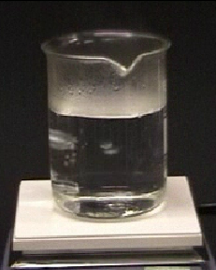
Boiling observations
Water has a boiling point of 100°C.
This water is being heated.
1. What temperature does the water start to boil?
A
Around 90°C
B
Around 98°C
C
100°C
D
Over 100°C

Slide 2
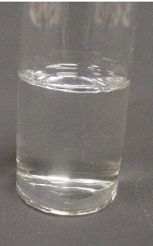
Boiling observations
This pure substance has a boiling point of 56°C.
The substance is going to be heated.
2. What temperature does the substance start to boil?
A
Around 50°C
B
Around 54°C
C
56°C
D
58°C

